Slide 1

BMI AND BMR CALCULATOR
-By YASH YADAV

Slide 2
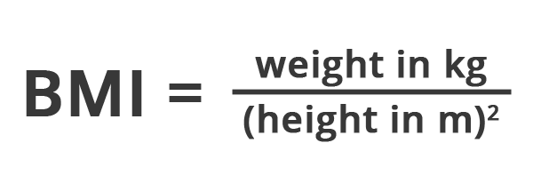
What is BMI ?
BMI :
Body mass index (BMI) is a person’s weight in kilograms divided by the square of height in meters. BMI is an inexpensive and easy screening method for weight category—underweight, healthy weight, overweight, and obesity.
Formula :

Slide 3
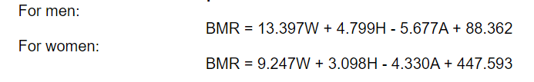
What is BMR ?
BMR:
The Basal Metabolic Rate (BMR) estimates - the amount of energy expended while at rest in a neutrally temperate environment, and in a post-absorptive state (meaning that the digestive system is inactive, which requires about 12 hours of fasting).
Formula:

Slide 4
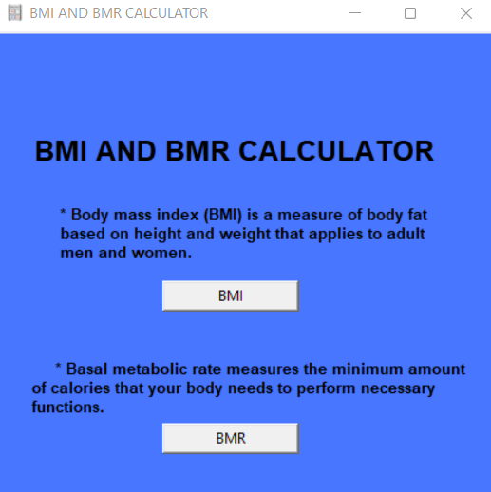
About CALCULATOR APP:
Calculates and display accurate BMI AND BMR of an Individual.
Shows the STATUS of the person whether he is fat, slim, healthy as per the given input.
Programming Language used – Python.
Moduel used for building app : Tkinter.

Slide 5
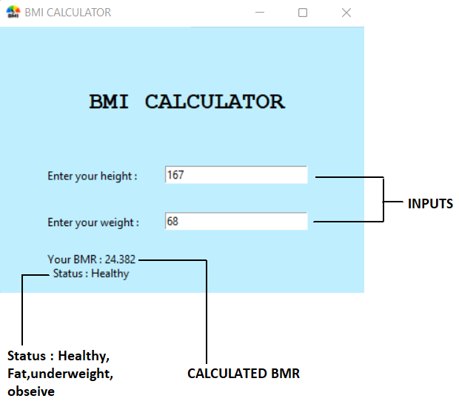
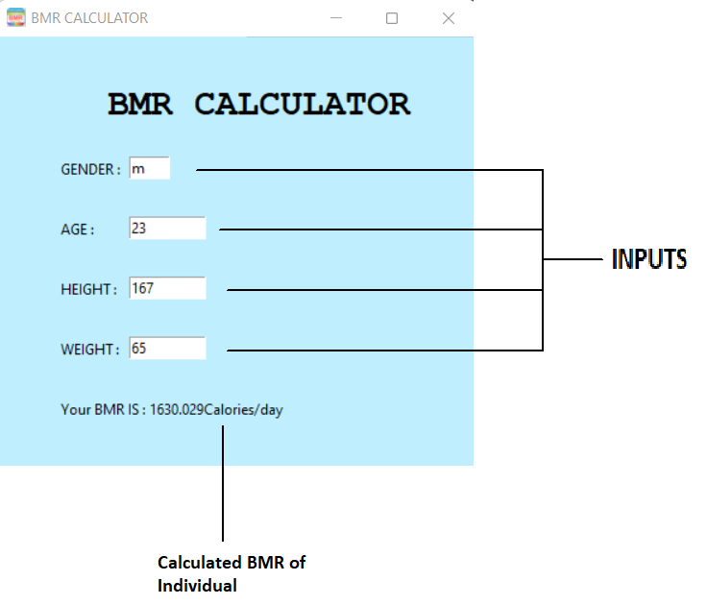
INTERFACE OF BMI AND BMR CALCULATOR

Slide 6
THANK YOU ☺

